Slide 1
Keeping a Book Available for Surveys and Inspections
Mary Ellen Conway
Capital Healthcare Group
Wednesday, June 7, 2023

Slide 2
About Your Speaker
Mary Ellen Conway
Nurse, healthcare consultant specializing in post acute areas of home health, DME, hospice, pharmacy and physician practice.
President of Capital Healthcare Group
  Consulting provider in Bethesda, MD founded in 2000.
  Helping both large and small providers and suppliers in managing their audit and regulatory compliance issues.
  Accreditation and state licensure survey issues.

Slide 3
Overview
You need to be prepared for a surveyor or inspector to visit your location during business hours at any time. You may not be available, but a staff person should be and have a binder with all of the information the inspector/surveyor would need to see just in case.
This may be a result of:
  A random on-site follow up done by your accreditor.
  A complaint made to your accrediting organization who then makes a site visit.
  Revalidation by the appropriate contractor
    Novitas
    Palmetto
  They are “just in the area.”
This book should be kept in a readily accessible area, not locked in your office.

Slide 4
Your Binder Should be a 2-inch Binder with Copies Placed in Transparency Sheets

Slide 5

Transparency Sheets
Allow you to rotate the out-of-date copies and replace them with the current, valid copy of documentation when they become available.

Slide 6
This Book Should Mimic What is Required in the Supplier Standards

Slide 7
Revocation of Your Supplier Number is No Joke

Slide 8
Revocations Governed by 42 CFR §424.535
Non-compliance with enrollment requirements (failure to comply with the supplier standards).
Supplier conduct
  Can revoke if (owner, managing employee, authorized or delegated official) is excluded from federal health care program, or
  Debarred, suspended, or otherwise excluded from participating in any other federal procurement or non-procurement program.

Slide 9
Revocations Governed by 42 CFR §424.535
Felonies – supplier, or any owner or managing employee of the provider or supplier was, within the preceding 10 years, convicted (that term is defined in 42 CFR 1001.2) of a federal or state felony offense that CMS determines is detrimental to the best interests of the Medicare program and its beneficiaries.
Felony crimes against persons.
Financial crimes such as extortion, embezzlement, tax evasion,
insurance fraud.
  Felony that places beneficiaries at immediate risk.
  Felony that could result in mandatory exclusion.
  Submitting false or misleading information on the enrollment application.
  Onsite Review – DME is not operational.

Slide 10
Revocations Governed by 42 CFR §424.535
Grounds related to screening requirements.
Misuse of billing number.
Abuse of billing privileges – CMS determines that the provider or supplier has a pattern or practice of submitting claims that fail to meet Medicare requirements.
Failure to comply with reporting requirements.
Medicaid termination.

Slide 11
Reapplying After Revocation
Revocation becomes effective 30 days after mailing of the notice of termination.
The re-enrollment bar begins 30 days after CMS or its contractor mails notice of the revocation.
Minimum of 1 year, but not greater than 3 years, depending on the severity of the basis for revocation.
The bar does not apply in the event a revocation based upon a supplier's failure to respond timely to a revalidation request or other request for information.
Supplier Standard #2:
  The supplier has not made, or caused to be made, any false statement or misrepresentation of a material fact on its application for billing privileges. The supplier must provide complete and accurate information in response to questions on its application for billing privileges. The supplier must report to CMS any changes in information supplied on the application within 30 days of the change.

Slide 12
If Your Supplier Number is Revoked
Contact Your DME Attorney Right Away
Can be addressed with a Plan of Correction if only for non-compliance with supplier standards.

Slide 13
In The Event of Revocation
You don’t have the routine 1 year/12 months to submit claims.
Claims for dates of service prior to revocation must be submitted within 60 days.

Slide 14
Reconsideration Appeal
Must be filed within 60 days even if decision on Corrective Action Plan has not yet been decided.
CMS has 90 days to make a decision.

Slide 15
New Rules for National Supplier Enrollment
Effective November 7, 2022, CMS awarded
Palmetto GBA the NPE West contract.
Novitas Solutions the NPE East contract, replacing the National Supplier Clearinghouse (NSC).
DMEPOS activities for suppliers located west of the Mississippi River continue to be administered by Palmetto GBA. DMEPOS activities for suppliers located east of the Mississippi River are now administered by Novitas Solutions.

Slide 16
What to Include in Your Book

Slide 17
1. Copies of All Licenses/Permits
All Required Licenses, including any zoning permits.
    Any and all State License(s), Occupancy Permit(s).
    Not all States have licenses for all that you provide.
Check requirements at Licensure Website (found on next slide).
Supplier Standard #1:
  Operates its business and furnishes Medicare-covered items in compliance with all applicable Federal and State licensure and
  regulatory requirements.

Slide 18
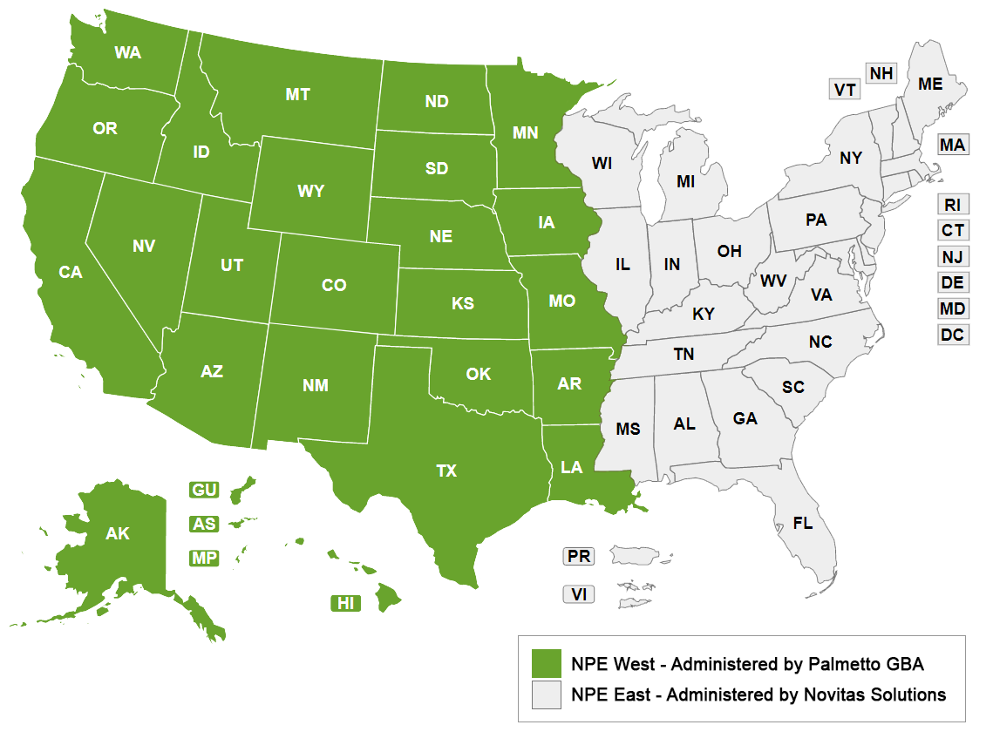
View Licensure Database
https://www.palmettogba.com/palmetto/npewest.nsf/DID/P4LF7PNQM8?Open

Slide 19
2. Credit Agreement(s) or
Copies of Invoices
Can be a contract or credit agreement from a manufacturer where you obtain product(s).
A sample copy of an invoice you have received for DME that you supply to show that you are obtaining your DME from a valid and reputable manufacturer.
Supplier Standard #4:
  Fills orders, fabricates, or fits items from its own inventory or by contracting with other companies for the purchase of items necessary to fill the order. If it does, it must provide, upon request, copies of contracts or other documentation showing compliance with this standard. A supplier may not contract with any entity that is currently excluded from the Medicare program, any State health care programs, or from any other Federal Government Executive Branch procurement or non-procurement program or activity.

Slide 20
3. Capped Rental/Inexpensive or Routinely Purchased Option Agreement
Show the text or form you provide on admission or services can be a form or a copy off the text and signature page from your Welcome Book/Admission Packet.
Supplier Standard #5:
  Advises beneficiaries that they may either rent or purchase inexpensive or routinely purchased durable medical equipment, and of the purchase option for capped rental durable medical equipment,. The supplier must provide, upon request, documentation that it has provided beneficiaries with this information, in the form of copies of letters, logs, or signed notice.

Slide 21
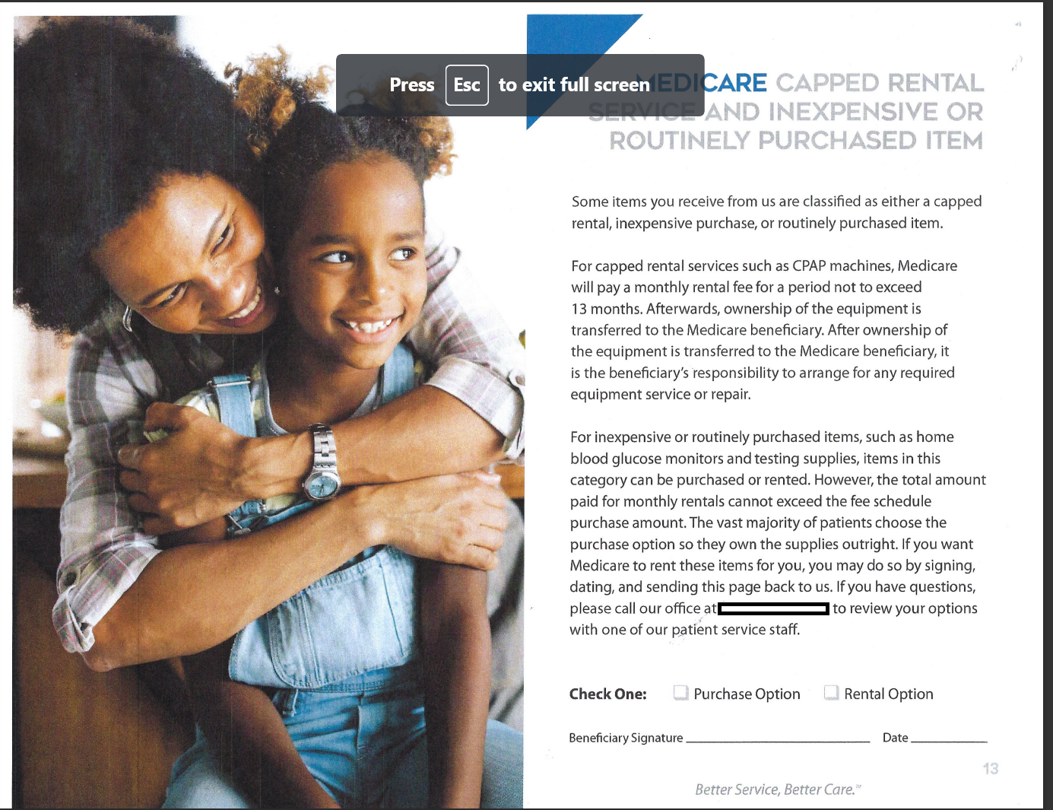
Sample Form from Welcome Booklet

Slide 22
4. Proof of Warranty Coverage
Often One Year.
Can be found in the Instructional or Paper Materials Found in Your Supplies or in your manufacturer contract.
Supplier Standard #6:
  Honors all warranties expressed and implied under applicable State law. A supplier must not charge the beneficiary or the Medicare program for the repair or replacement of Medicare covered items or for services covered under warranty. This standard applies to all purchased and rented items, including capped rental items, as described in §414.229 of this subchapter. The supplier must provide, upon request, documentation that it has provided beneficiaries with information about Medicare covered items covered under warranty, in the form of copies of letters, logs, or signed notices.

Slide 23
5. Accessibility to Physical Space
Should be self-evident to inspector/reviewer as he/she arrives, but take this opportunity to clear hallways, unblock doors, ensure exit routes are posted, clear any clutter, make sure shelves are not stacked to the ceiling, both in office and warehouse locations.

Slide 24
6. Hours of Operation
Must be posted on your front door and in building directory (both).
Must show that you are open 30 hours per week (Medicare requirement). Can close for lunch/deliveries on business days but must show open 30 hours total (or more) per week.
Supplier Standard #30:
A supplier must remain open to the public for a minimum of 30 hours per week except physicians (as defined in section 1848(j) (3) of the Act) or physical and occupational therapists or a DMEPOS supplier working with custom made orthotics and prosthetics.
Supplier Standard #8:
  Permits CMS, or its agents to conduct on-site inspections
  to ascertain supplier compliance with the requirements
  of this section.
  The supplier location must be accessible during reasonable business hours to beneficiaries and to CMS and must maintain a visible sign and posted hours of operation.

Slide 25
Sample Business Hours
Monday- Friday 8 A.M. – 6 P.M.
Closed for Lunch/Deliveries 1 – 3 P.M. each Day
Saturdays 9 A.M. – 12 P.M.

Slide 26
7. Comprehensive Liability Insurance or Certificate showing the correct National Provider Enrollment Entity
Palmetto GBA – the NPE West contract
Novitas Solutions – the NPE East contract, replacing National Supplier Clearinghouse (NSC)
“”of your call-center being down (and your customers getting angry) when the next disaster strikes.

Slide 27
Supplier Standard #10
The supplier has a comprehensive liability insurance policy in the amount of at least $300,000 that covers both the supplier's place of business and all customers and employees of the supplier. In the case of a supplier that manufactures its own items, this insurance must also cover product liability and completed operations. Failure to maintain required insurance at all times will result in revocation of the supplier's billing privileges retroactive to the date the insurance lapsed.

Slide 28
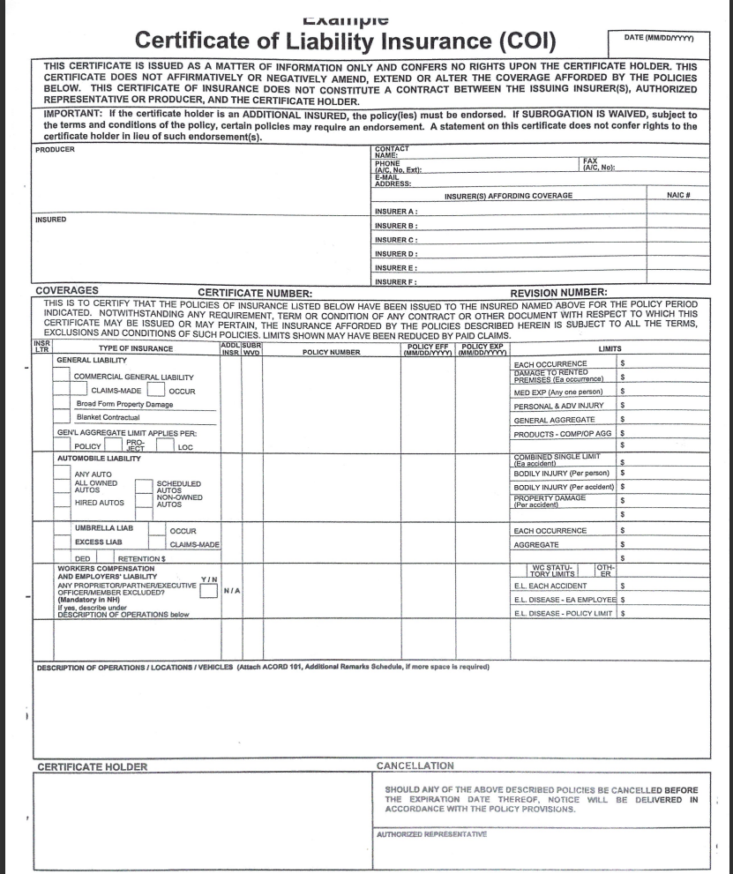
Sample Form

Slide 29
Proof that the Company is listed in a local Directory and Square Footage Required
Medicare does not want you to run your business on a cell phone — a copy of a listing (Yellow Pages) or ad somewhere will help show that you have a landline for service.
Supplier Standard #9:
  Maintains a primary business telephone listed under the name of the business locally or toll-free for beneficiaries. The supplier must furnish information to beneficiaries at the time of delivery of items on how the beneficiary can contact the supplier by telephone. The exclusive use of a beeper number, answering service, pager, facsimile machine, car phone, or an answering machine may not be used as the primary business telephone for purposes of this regulation.

Slide 30
Square Footage Requirement
At least 200 square feet.
Supplier Standard #7 requires that you:
    Maintain a physical facility on an appropriate site. The physical facility must contain space for storing business records including the supplier's delivery, maintenance, and beneficiary communication records. For purposes of this standard, a post office box or commercial mailbox is not considered a physical facility. In the case of a multi-site supplier, records may be maintained at a centralized location.
If using a contract group space, all reception, kitchen, conference room space applies.

Slide 31
9. Documentation/Information provided to beneficiaries on use/maintenance of supply
Copy of instructional materials that come with the item– not just the care and maintenance information provided.
Could use VGM “Blue Sheets” or other similar types of documentation.

Slide 32
10. Beneficiary Copy of the Supplier Standards
From your Admission Paperwork or Welcome Booklet.

Slide 33
Supplier Standards
All Medicare DMEPOS suppliers must be in compliance with these Supplier Standards in order to obtain and retain their billing privileges. These standards, in their entirety, are listed in 42 C.F.R. pt. 424, § 424.57(c) and went into effect December 11, 2000. A supplier must disclose (provide a copy of) these standards to all customers/patients who are Medicare beneficiaries (Standard 16).
A shortened version has been created to help suppliers comply
with this requirement.

Slide 34
Alternatively
“The products and/or services provided to you by insert your company name here are subject to the Supplier Standards contained in the federal regulations shown at 42 Code of Federal Regulations, Section 424.57 C. These standards concern business professional and operational matters (e.g., honoring warranties and hours of operation). The full text of these standards can be obtained from the US Government Printing Office website external link at http://ecfr.federalregister.gov/on/2021-02-03/title42/chapter-IV/subchapter-B/part424/subpart-D/section-424.57. Upon request, we will furnish you with a written copy.”

Slide 35
11. Listing of all Management/ Owners Including Name and Title
Sample
John Smith, Chief Operating Officer
Adam Jones, Chief Financial Officer
Karen Adams, Chief Compliance Officer
  Can include home address but should not include any private information.

Slide 36
12. Complaint Resolution Process
Place your entire complaint process here. Insert a copy of a blank or a sample completed complaint form. Your complaint form must include
1. The beneficiary’s name, address, telephone number, and health insurance claim number.
  Your process must include a summary of the complaint; the date it was received; the name of the person receiving the complaint, and a summary of actions taken to resolve the complaint.
    If an investigation was not conducted, the name of the person making the decision and the reason for the decision.

Slide 37
Complaint Log Format

Slide 38
Supplier Standards Regarding Complaints
Standard #13:
  A supplier must maintain documentation of contacts with beneficiaries regarding complaints or questions.
Standard #20:
  Must have a complaint resolution protocol to address beneficiary complaints that relate to supplier standards in paragraph (c) of this section and keep written complaints, related correspondence and any notes of actions taken in response to written and oral complaints. Failure to maintain such information may be considered evidence that supplier standards have not been met. (This information must be kept at its physical facility and made available to CMS upon request.)

Slide 39
13. Copies of Complaint Log – Sample
Included in the documentation of your process.

Slide 40
14. Accreditation Information
Supplier Standard #22:
  All suppliers of DMEPOS and other items and services must be accredited by a CMS-approved accreditation organization in order to receive and retain a supplier billing number. The accreditation must indicate the specific products and services, for which the supplier is accredited in order for the supplier to receive payment for those specific products and services.
Provider enrollment must show that you have been accredited to provide a particular supply at that location (Comprehensive Product List).
Supplier Standard #23:
  All DMEPOS suppliers must notify their accreditation organization when a new DMEPOS location is opened. The accreditation organization may accredit the new supplier location for three months after it is operational without requiring a new site visit.

Slide 41
Accreditation
Your certificate should show the address of each location– if branches or satellites, include the copies that show accreditation for each.
Supplier Standard #24
  All DMEPOS supplier locations, whether owned or subcontracted, must meet the DMEPOS quality standards and be separately accredited in order to bill Medicare. An accredited supplier may be denied enrollment or their enrollment may be revoked, if CMS determines that they are not in compliance with the DMEPOS quality standard.
Supplier Standard # 25
  All DMEPOS suppliers must disclose upon enrollment all products and services, including the addition of new product lines for which they are seeking accreditation. If a new product line is added after enrollment, the DMEPOS supplier will be responsible for notifying the accrediting body of the new product so that the DMEPOS supplier can be re-surveyed and accredited for these new products.

Slide 42
15. Surety Bond Information
Copy of Face Sheet showing valid date and expiration date.

Slide 43
Table of Contents Review

Slide 44
Required Licenses, including any zoning/occupancy permits
(42 CFR §424.57 c 1,7)
Copy of Credit Agreement(s) or Invoice(s)
(42 CFR § 424.57 c 4)
Capped Rental/Inexpensive or Routinely Purchase Option Agreement Provided to Benes
(42 CFR § 424.57 c 5)
Proof of Warranty Coverage
(42 CFR § 424.57 c 6)
Accessibility to Physical Site
N/A
Hours of Operation
(42 CFR § 424.57 C 1,7)

Slide 45
Comprehensive Liability Insurance/ Certificate of Insurance Showing the NSC as the Certificate Holder
( 42 CFR 424.57 c 10)
Proof that the Company is Listed in the Local Directory and Square Footage
(Yellow Pages or Other Ad and Lease)
Documentation of Written Instruction(s) Supplied to the Beneficiary on the Use/Maintenance of DME Provided
(42 CFR § 424.57 C 12)
Beneficiary Copy of Current Supplier Standards or Written Information
(42 CFR § 424.57 C 16)
Listing of All Management/Owners Including Name and Title
(42 CFR § 424.57 C 17)

Slide 46
Complaint Resolution Process
(42 CFR § 424.57 C 19)
Copy of Complaint Log
(42 CFR § 424.57 C 20)
Accreditation Information
(42 CFR § 424.57 C 22)
Copy of Surety Bond Agreement
(42 CFR § 424.57 C 26)

Slide 47
Questions?

Slide 48
Thank you
Mary Ellen Conway
President, Capital Healthcare Group
maryellen@capitalhealthcaregroup.com

